Slide 1

Pattern Recognition
Brac University

Slide 2
What is Pattern Recognition ?
Pattern recognition is a branch of machine learning and artificial intelligence that focuses on the automatic detection, classification, and interpretation of patterns in data such as images, signals, text, or numbers.
In short:
The process of automatically identifying and classifying patterns in data based on extracted features.

Slide 3
How pattern recognition works ?
Input data – image, sound, text, sensor data
Feature extraction – meaningful characteristics are identified
Pattern classification – the data is assigned to a class
Decision – final recognition result

Slide 4
Real-life examples
📷 Face recognition in phones
🗣️ Speech recognition (voice assistants)
✍️ Handwritten digit recognition
📧 Spam email detection
🧬 Medical diagnosis from scans
🎥 Recommendation Systems
🚗 Self-Driving Cars
🛒 Fraud Detection
🧠 Fingerprint & Biometric Systems
📊 Stock Market Prediction

Slide 5
🤖 In AI & Machine Learning
Pattern recognition helps systems:
Learn from examples
Generalize to new, unseen data
Make accurate predictions
Modern pattern recognition heavily uses:
Neural networks
Deep learning
Statistical models

Slide 6
Types of Pattern Recognition
1️⃣ Statistical (including Probabilistic) Pattern Recognition
2️⃣ Structural (including Syntactic) Pattern Recognition
3️⃣ Neural Pattern Recognition
4️⃣ Template Matching
5️⃣ Fuzzy Pattern Recognition
6️⃣ Hybrid Approaches

Slide 7
Contents
Core tasks:
Classification (discrete outputs)
Regression (continuous outputs)
Density estimation & clustering
Learning paradigms:
Supervised
Unsupervised
Reinforcement learning
Why ML matters: automation, generalization, scalability

Slide 8
Classification (discrete outputs)
Classification (discrete outputs) is a type of pattern recognition task where the system assigns an input to one of a fixed set of predefined classes.
🧠 Key idea
Outputs are discrete (not continuous)
Each input belongs to one class (or sometimes multiple, in multi-label cases)

Slide 9
Classification (discrete outputs) [cont…]
📊 Examples
Input | Output (Class)
Email | Spam/ Not Spam
Image | Cat/ Dog
Handwritten Digits | 0-9
Medical Data | Disease A/ Disease B
Student Record | Pass/ Fail

Slide 10
Classification (discrete outputs) [cont…]
🧪 Types of classification
Binary classification → 2 classes (Yes / No)
Multi-class classification → more than 2 classes
Multi-label classification → multiple classes at once

Slide 11
Classification (discrete outputs) [cont…]
🤖 Common classification algorithms
k-Nearest Neighbors (k-NN)
Decision Trees
Naive Bayes
Support Vector Machines (SVM)
Neural Networks
Generalized Linear Model (GLM)
Logistic regression

Slide 12
Regression (continuous outputs)
Regression is the process of learning a mapping from input variables to continuous numerical values.
🧠 Key idea
Outputs are continuous, not categories
Small changes in input can cause small changes in output

Slide 13
Regression (continuous outputs) [cont…]
📊 Examples
Input | Output (Class)
House features | House price
Time | Temperature
Student study hours | Exam score
Sensor readings | Voltage
Medical data | Blood pressure

Slide 14
Regression (continuous outputs) [cont…]
🤖 Common regression algorithms
Linear Regression
Polynomial Regression
Ridge & Lasso Regression
Support Vector Regression (SVR)
Neural Networks

Slide 15
Quick Contrast
🔁 Regression vs Classification
Regression → continuous outputs (price, weight, temperature)
Classification → discrete outputs (spam/not spam, cat/dog)

Slide 16
Density estimation & clustering
Density estimation and clustering are two closely related tasks in pattern recognition that deal with understanding the structure of data, often without labeled outputs.
In short: The process of estimating the probability distribution of data points in a feature space.
🧠 Key idea
Models how likely data points are to occur
Helps identify regions of high and low data concentration

Slide 17
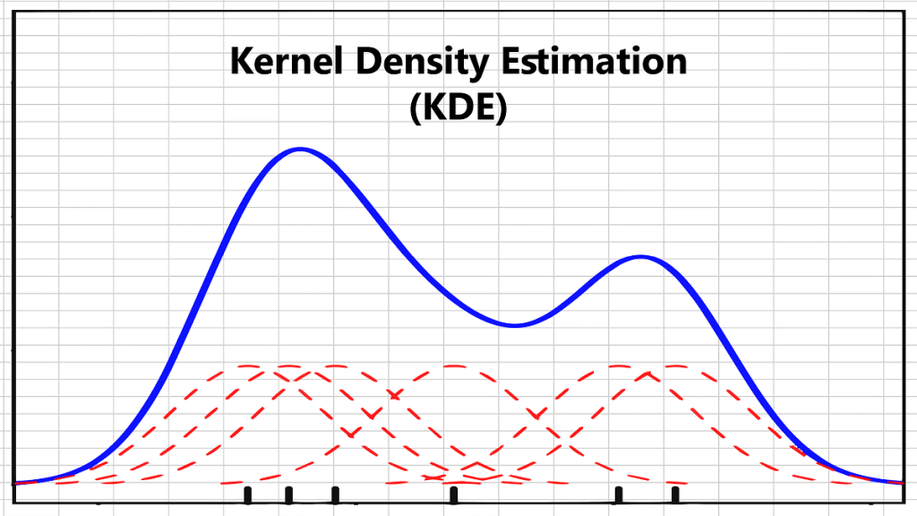
Density estimation
📊 Examples
Estimating the distribution of heights in a population
Modeling pixel intensity distribution in an image
Detecting anomalies (low-density regions)
🔧 Types of density estimation
Parametric → assumes a form (e.g., Gaussian)
Non-parametric → no fixed form (e.g., Kernel Density Estimation)

Slide 18
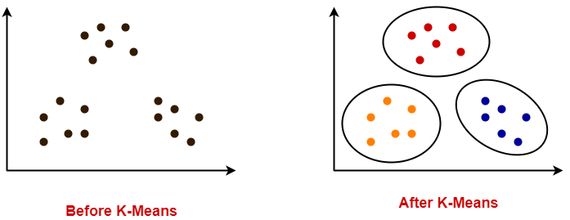
Clustering
Clustering is the process of grouping similar data points into clusters such that:
Data points in the same cluster are similar
Data points in different clusters are dissimilar
🧠 Key idea
No predefined labels
Groups are discovered automatically

Slide 19
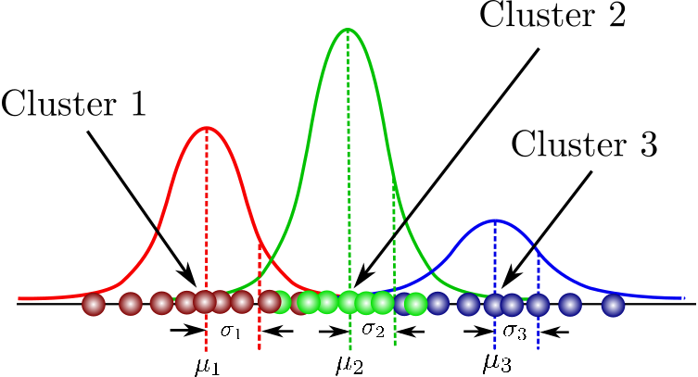
Clustering [contd…]
Common clustering algorithms
k-Means
Hierarchical clustering
DBSCAN
Gaussian Mixture Models (GMM)
GMM

Slide 20
Clustering [contd…]
🔁 Relationship between Density Estimation & Clustering
High-density regions often form clusters
Many clustering methods (like GMM) are based on density estimation
🧪 Quick comparison
Aspect | Density Estimation | Clustering
Output | Probability density | Group labels
Labels needed | No | No
Focus | Distribution | Grouping

Slide 21
Learning paradigms:
Supervised
Unsupervised
Reinforcement learning
Hybrid Models

Slide 22
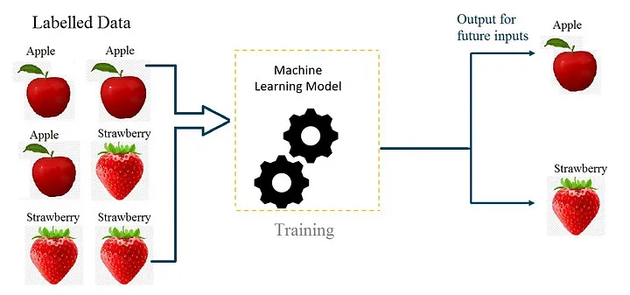
Supervised Learning
Supervised learning is a machine learning and pattern recognition approach where a model learns from labeled training data to make predictions on new, unseen data.
🤖 Common supervised learning algorithms
Linear & Logistic Regression
k-Nearest Neighbors (k-NN)
Decision Trees & Random Forests
Support Vector Machines (SVM)
Neural Networks

Slide 23
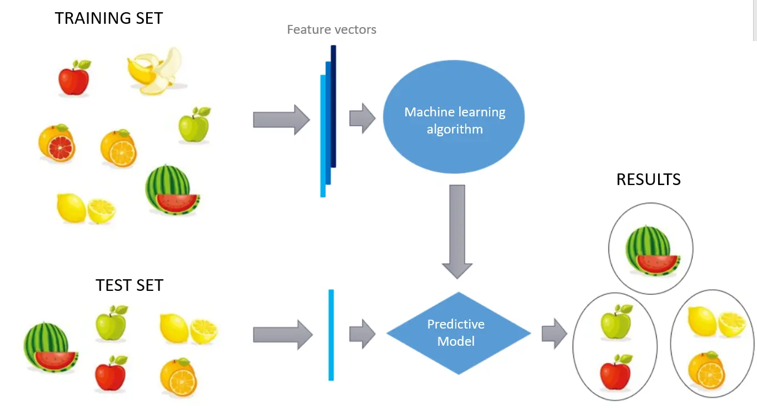
Unsupervised Learning
Unsupervised learning is a machine learning and pattern recognition approach where a model learns without labeled output data and discovers hidden patterns or structure in the input data.
🤖 Common unsupervised learning algorithms
k-Means
Hierarchical clustering
DBSCAN
Gaussian Mixture Models (GMM)
Principal Component Analysis (PCA)

Slide 24
Reinforcement Learning
Reinforcement learning (RL) is a type of machine learning where an agent learns by interacting with an environment and improves its behavior through rewards and penalties.
🔄 Learning cycle
Agent observes the state
Agent takes an action
Environment gives a reward
Agent updates its policy

Slide 25
Reinforcement Learning [contd…]
📊 Examples
Game playing (chess, Go, video games)
Robot navigation
Self-driving cars
Recommendation systems
Resource management
🤖 Common reinforcement learning algorithms
Q-Learning
SARSA
Deep Q-Networks (DQN)
Policy Gradient methods

Slide 26
🔁 Comparison with other learning types
Supervised → learns from labeled data
Unsupervised → finds structure in unlabeled data
Reinforcement → learns from rewards and penalties

Slide 27
🔹 Automation
ML enables automatic decision-making without explicit rules.
Reduces human effort in repetitive tasks
Learns patterns instead of being hand-coded
Works in complex or changing environments
Examples:
Spam filtering
Face recognition
Automatic grading systems

Slide 28
🔹Generalization
ML models can perform well on unseen data, not just the data they were trained on.
Learns underlying patterns, not memorized examples
Makes predictions on new inputs
Essential for real-world use

Slide 29
🔹 Scalability
ML systems can handle large volumes of data and grow with increasing demand.
Works with millions or billions of samples
Performance improves with more data
Can be deployed across many users and systems
Examples:
Recommendation systems (Netflix, YouTube)
Search engines
Large-scale fraud detection

